Slide 1

Christopher B. Barrett
World Food Prize New York Youth Institute
March 29 2019
Meeting The Global Food Security Challenges Of The 21st Century

Slide 2
Food security is essential to human flourishing
Food security exists if and only if
“all people at all times have physical, social, and economic access to sufficient, safe and nutritious food that meets their dietary needs and food preferences for an active and healthy life”
(1996 World Food Summit definition, emphasis added)

Slide 3
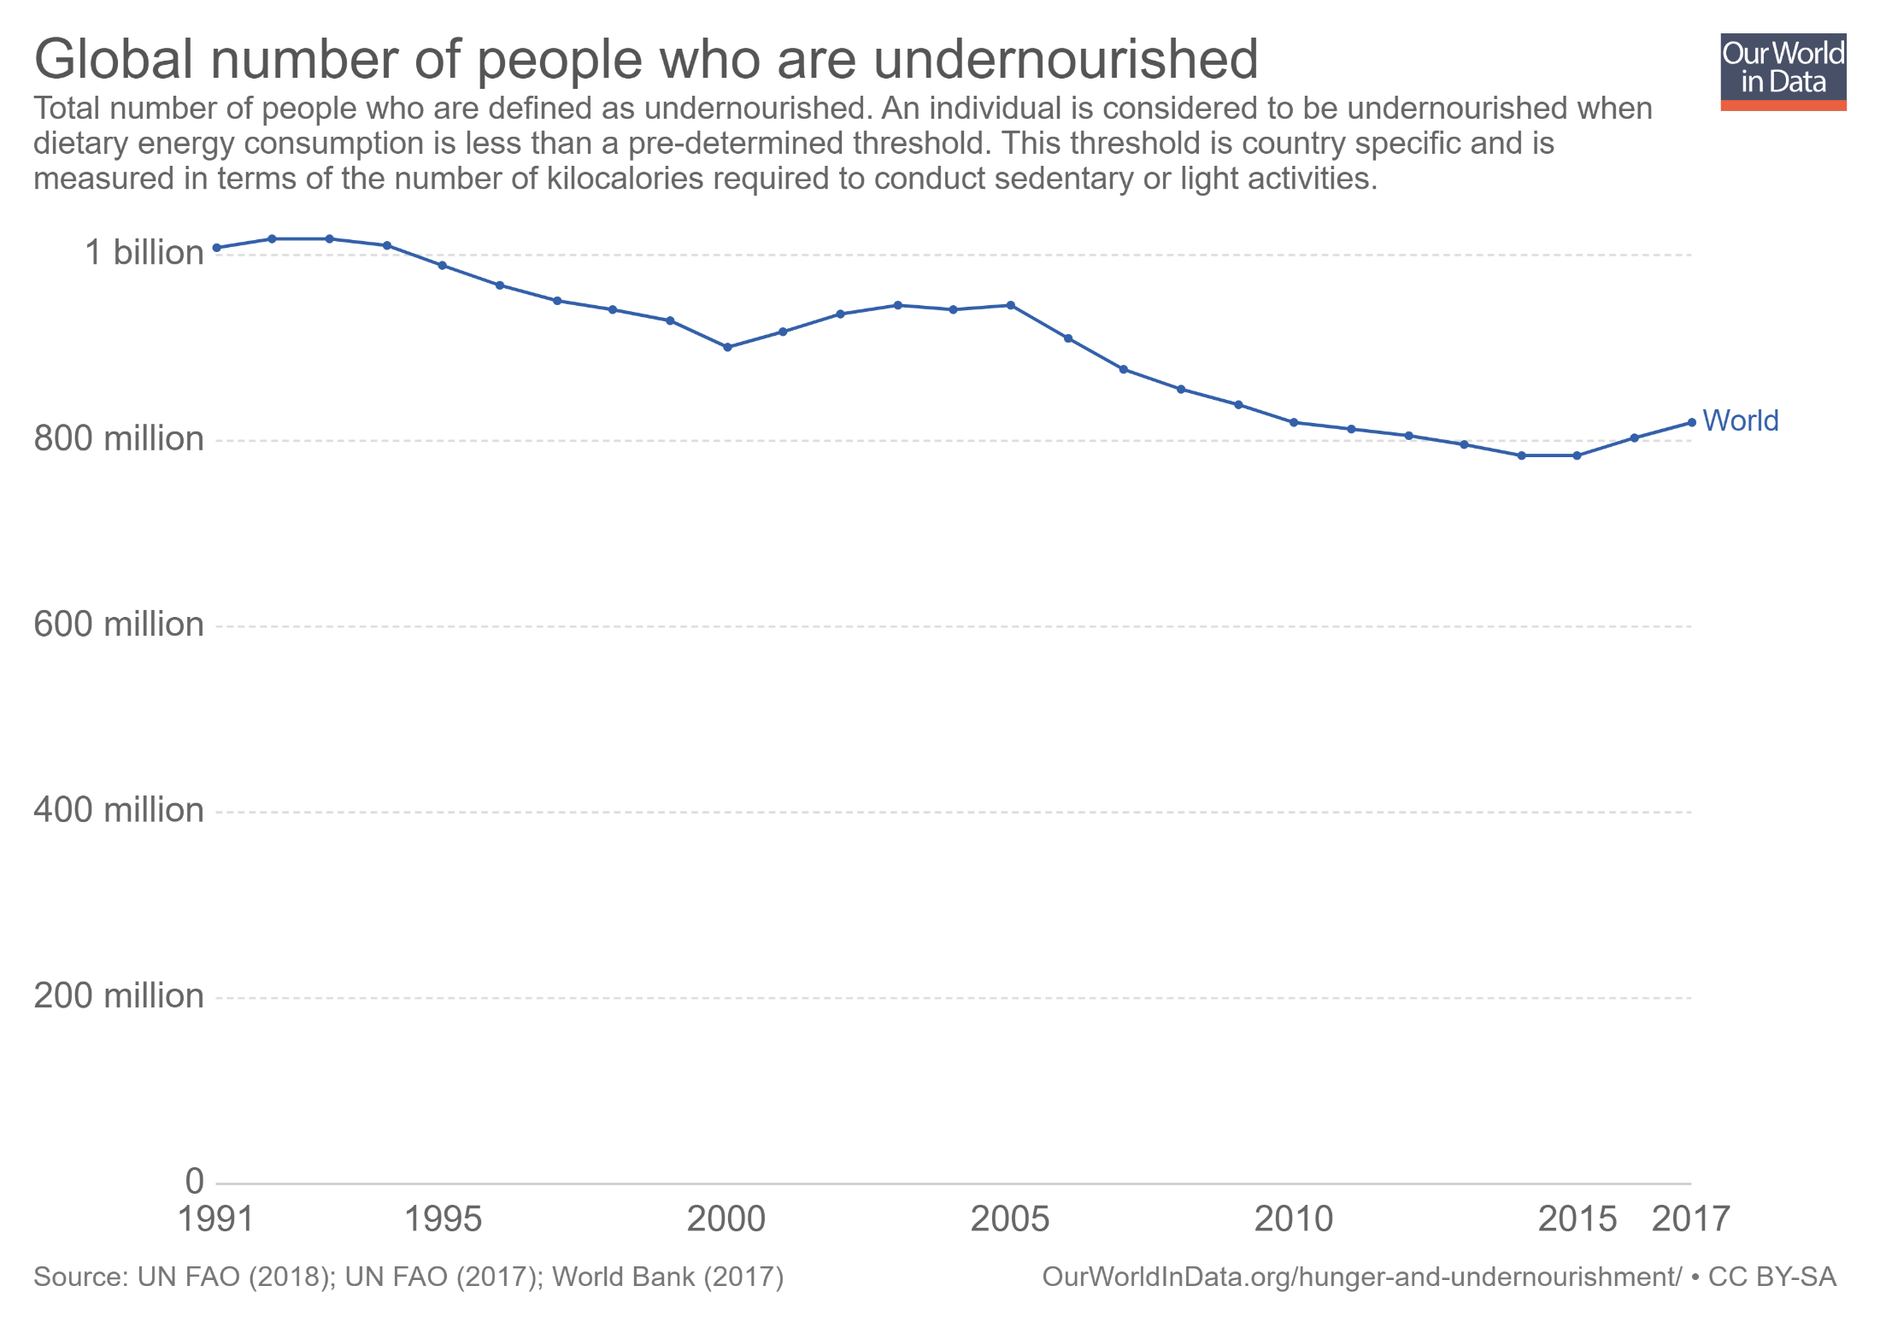
Remarkable progress
Meanwhile, global population has grown from 5.4 bn to 7.6 bn over the same period!
So an increase of ~2.5 bn people adequately nourished in a quarter century … 90 mn people/year escaped hunger!

Slide 4
Stagnation or reversal
Bull still high (even growing) levels of undernutrition:
1.6 bn suffer iron- or vitamin B₁₂ deficiency anemia
… and growing!
0.8 bn with insufficient dietary energy (i.e., calorie) intake
… and stopped falling (slight increase last 2 years)!
33/15% of pre-school age children/pregnant women at risk of vitamin A deficiency
zinc deficiency prevalence 40-70% in low-income Asia/Africa
Sources: FAO et al. 2017; WHO 2008, 2009.
We lack rigorous, recent estimates of the population suffering shortfalls of any one or more nutrient, although the number is surely billions. We can’t manage what we don’t measure!

Slide 5
Growing challenges
Looking forward, challenges may be tougher
Although absolute poverty has fallen, relative suffering has grown w/increased inequality within societies, sowing disunity.
Human suffering is more spatially concentrated. In 1990 Africa was home to 119 mn (24%) of the world’s ultra-poor (<$0.95/day pc) … but grew to 133 mn (82%) by 2011. Poverty traps increasingly salient to the remaining poor.
Complex humanitarian emergencies: 4 (near-)famines for first time in modern history … conflict + poverty + natural disasters has led to increasingly challenging acute conditions.
Climate change, water/soil nutrient constraints, changing pest/ pathogen pressures pose rising production challenges.

Slide 6
Growing challenges
It helps to unpack by the four pillars of food security:
Availability: Food must be available in sufficient quantities. Supply-side necessary condition that considers production flows and carryover stocks available locally from production, trade, or aid.
Access: People must be able to regularly acquire adequate quantities of food. Demand-side necessary condition that considers purchase, home production, barter, gifts, borrowing, and safety nets.
Utilization: Consumed food must have a positive nutritional impact. It entails cooking, storage and hygiene practices, individuals’ health, water and sanitation, feeding and sharing practices within the household. Nutrient composition and disease status are key.
Stability: Must be able to maintain access and utilization over time, through lean seasons, disasters, price spikes, etc. Resilience is key.

Slide 7
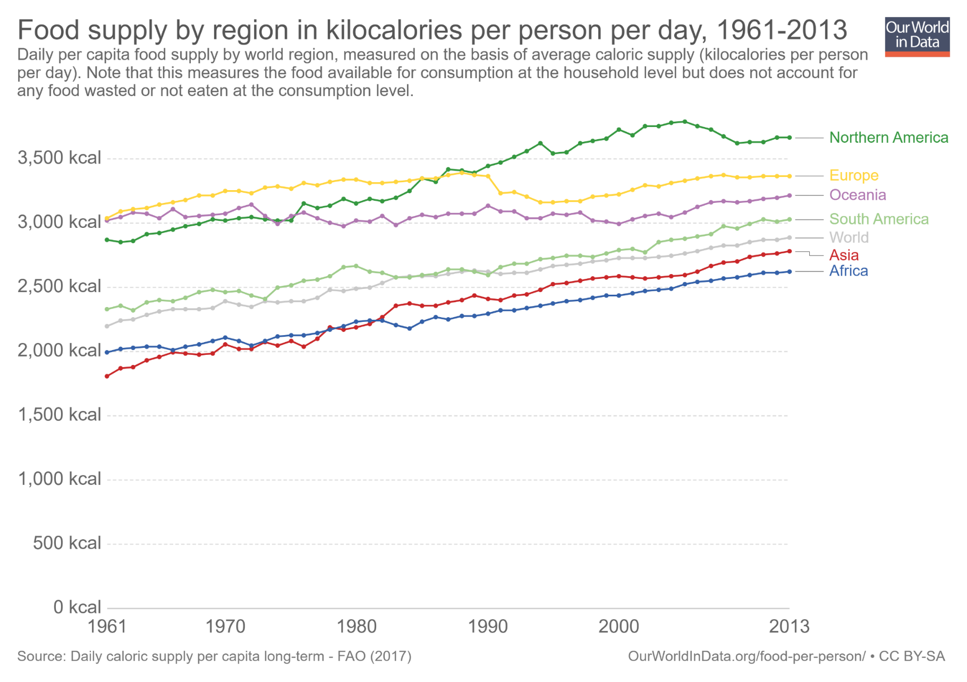
Availability progress
Great progress in raising calorie availability …
2011-13 min. dietary energy req’t [1770,2340]

Slide 8
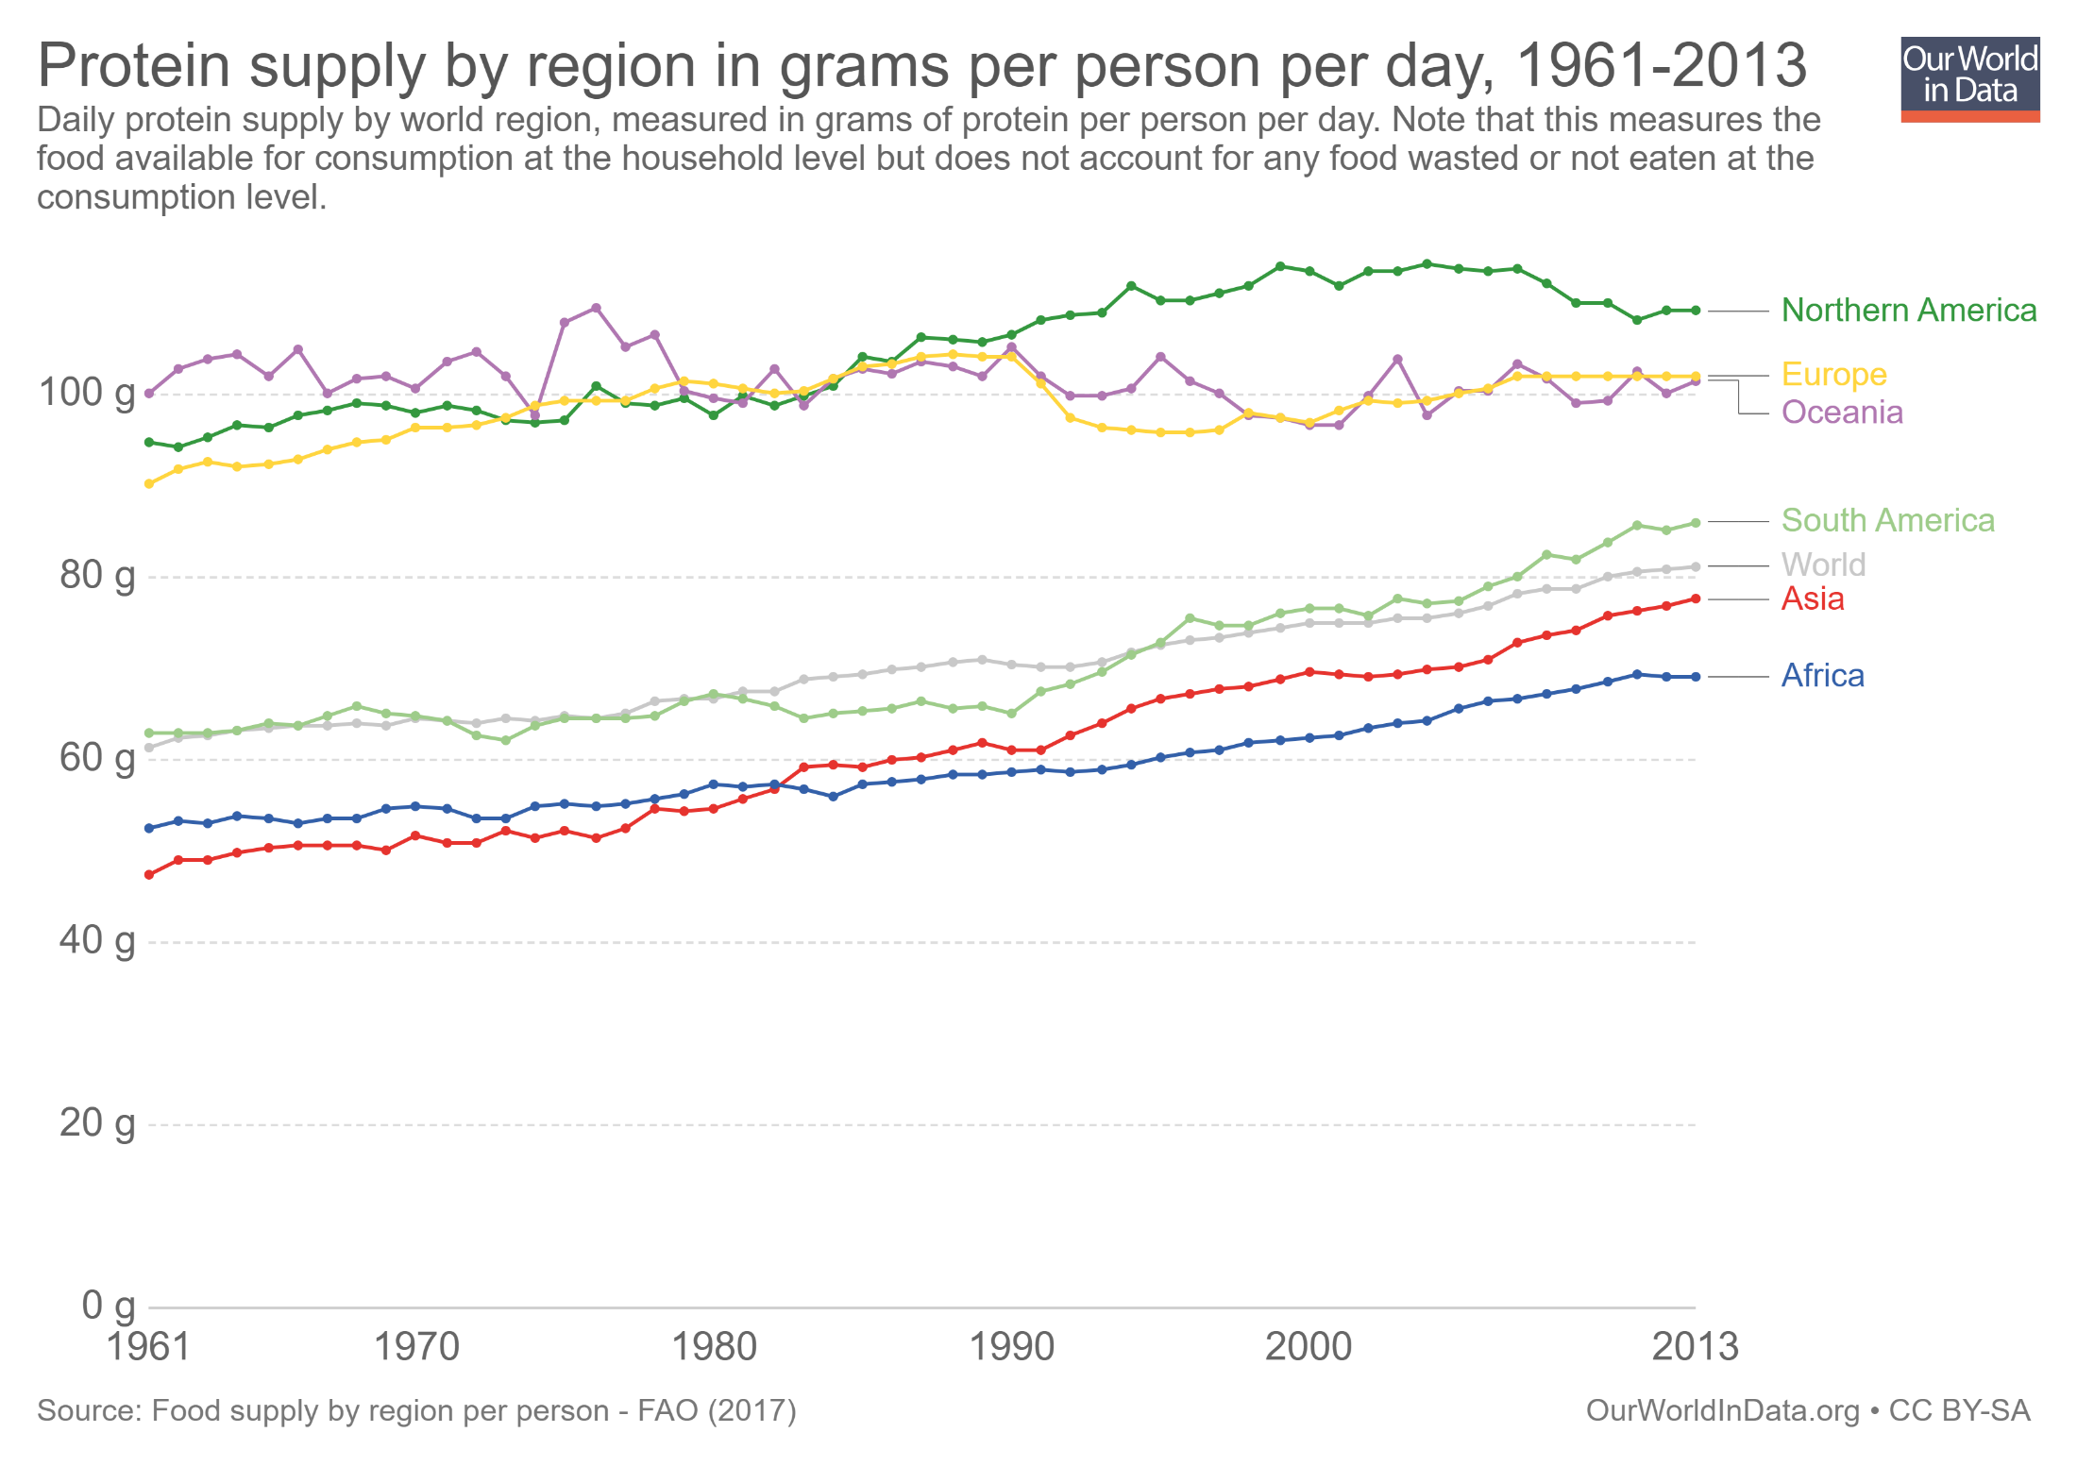
Availability progress
… and protein availability
Daily protein req’t:
45-55 g/day global avg
(0.8g p/kg body weight)

Slide 9
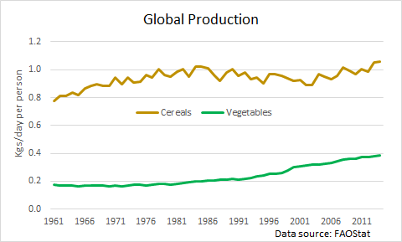
Availability challenges
Challenge: Supply of vitamin/mineral rich foods not increasing fast enough for dietary transition
Especially true given loss/waste rates ≥50% higher for vegetables due to perishability and vitamin loss, and relative price increases due to differences in demand elasticities.

Slide 10
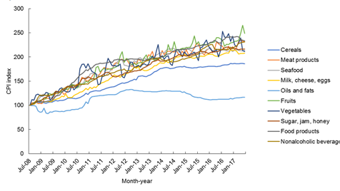
Availability challenges
Result: relative prices of more nutritious foods increase faster than less nutritious foods
Example: In Pakistan, fruit/veg/ASF prices have increased 2-2.5x those of oils/fats and 25-75% > cereals
(Source: Dizon & Herforth 2018 WB PRWP)

Slide 11
Availability challenges
Innovations must boost food supplies to keep pace with demand growth from rising population and incomes plus urbanization. Must address planetary boundaries that limit input expansion.
Land: - Arable land fixed without major (ecologically risky) conversion of forest, wetlands, or drylands
Soil nutrient depletion (esp. N, P and minerals)
Increasing urban/protected area competition for land
Water: - Ag already accounts for ~70% of human water usage, > 80% in Africa and Asia
Climate change will aggravate water shortages
Fisheries: Marine capture fisheries stable or declining

Slide 12
Availability challenges
So must rely mainly on technological advances to boost agricultural productivity. But…
  Site specificity due to agroecological heterogeneity … so need lots of adaptive research/innovations
  Innovation most needed in Africa/Asia, where demand growth will occur but ag R&D capacity also most limited
  Technological advance requires investment, and governments and philanthropies are essential but insufficient … will rely heavily on the private sector.
  Private IP regimes increasingly pose obstacles
  Challenge of widespread opposition to transgenics and gene editing, although these are essential options for some products/challenges

Slide 13
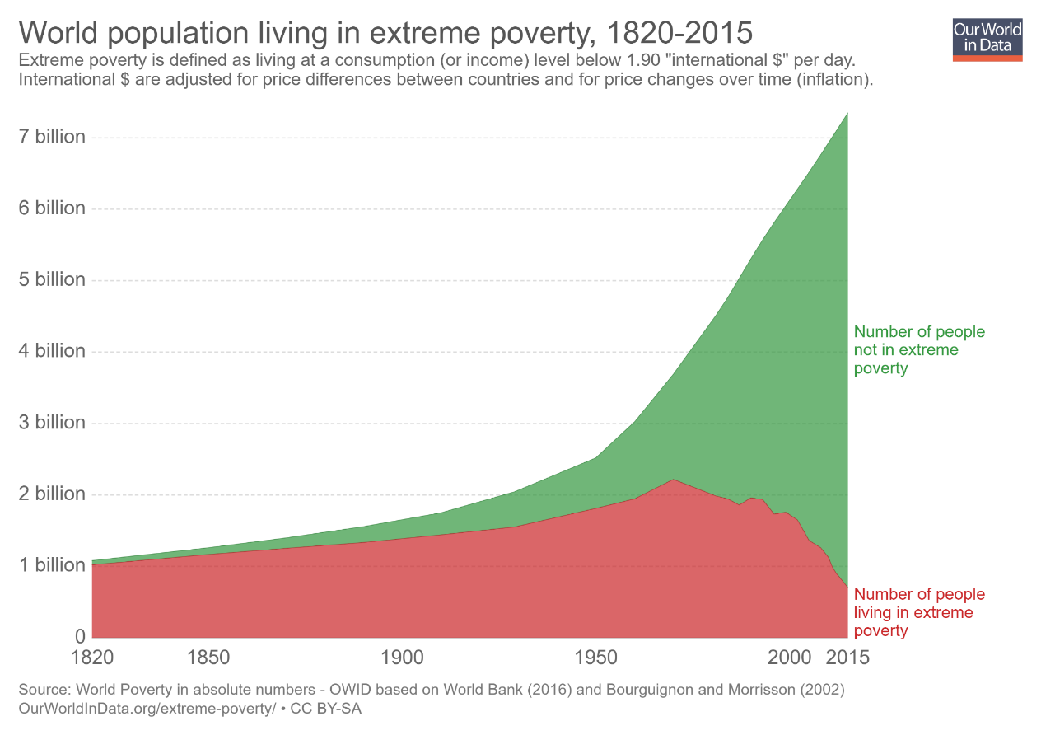
Access progress
“Starvation is the characteristic of some people not having enough food to eat. It is not the characteristic of there being not enough food to eat.” (emphasis in original)
- Opening sentences, Amartya Sen, Poverty and Famines, 1981
Poverty is the key driver of food insecurity/ undernutrition.
Historically unprecedented decline in global poverty, plus declining real food prices, dramatically improved food access.

Slide 14
Access progress
Growth in safety nets, especially cash and in-kind transfer programs, along with employment guarantee schemes, have dramatically expanded access for the poor:
130 low- and middle-income countries now have at least one non-contributory unconditional cash transfer program (Bastagli et al. ODI 2016)
~1.5 bn beneficiaries of government-run food assistance programs (mostly in –kind) (Alderman et al. 2018)
Emergency response advances by humanitarian organizations have dramatically improved early warning and targeting, and accelerated response times.

Slide 15
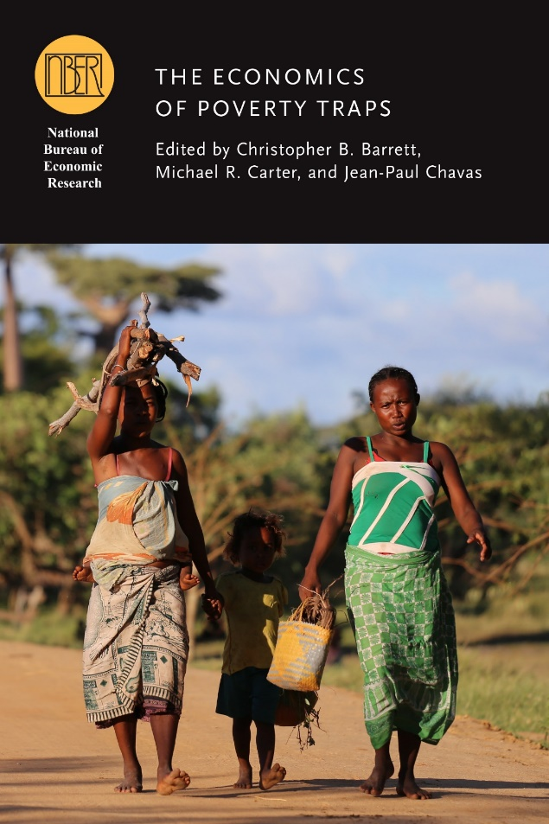
Access challenges
Poverty traps arise when self-reinforcing feedback from poor ‘initial conditions’ lead to optimal behaviors that perpetuate poverty. As global poverty rates fall, the toughest cases remain, concentrated in the most remote, dangerous places.
Examples:
- malnutrition causes poverty, which itself leads to further malnutrition (lifelong for kids).
- high risk exposure leads to risk averse livelihood strategies that lock in poverty.
- discrimination against certain identities discourages people from acquiring skills, thereby reinforcing harmful stereotypes.
- shocks cause psychological trauma that dampens hope and increases stress, reducing effort, investment and productivity.

Slide 16
Access challenges
Must advance the poor’s access …
to new technologies: save lives and enhance livelihoods. Example: mobile money, irrigation
to finance: savings/insurance/credit to enable investment and shield against shocks
to markets (esp. labor markets): fair, competitive exchange enhances the value of what the poor own/produce
to safety nets: need reliable protection against grave dangers, esp. those that directly or indirectly imperil health
to early childhood health, nutrition and education
… empower the poor to invest in human (and other) capital and thereby realize full potential and flourish

Slide 17
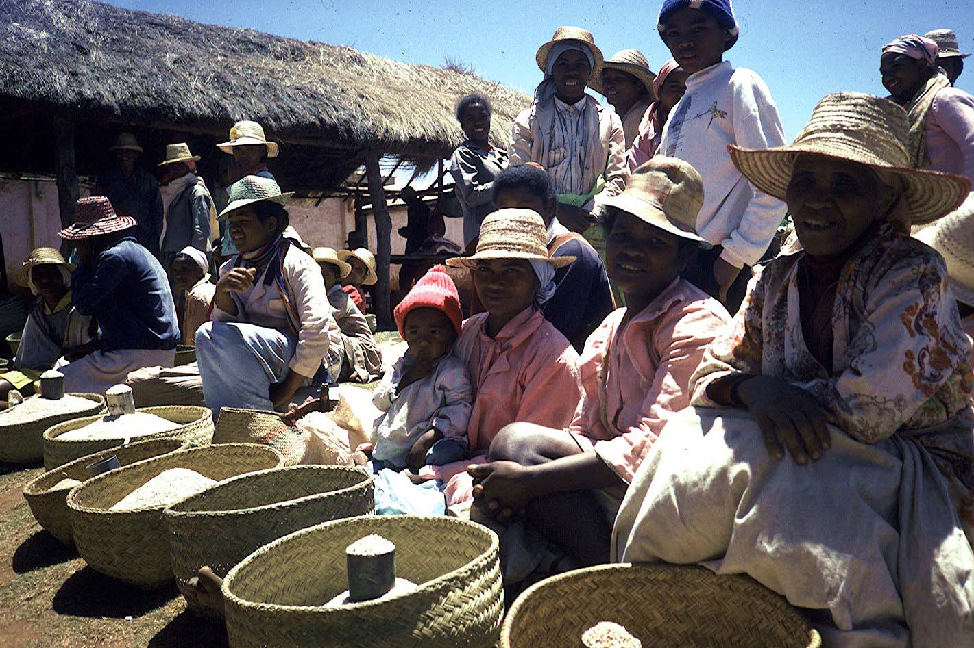
Utilization challenges
Because 75-80% of food is consumed within the country where it is grown, food system performance improvements must occur in Africa/Asia, where most demand growth will occur this century.
As populations urbanize, post-harvest food value chains grow ever more important. Must improve food quality and safety, not just expand food production, to address changing human dietary needs/demands.

Slide 18
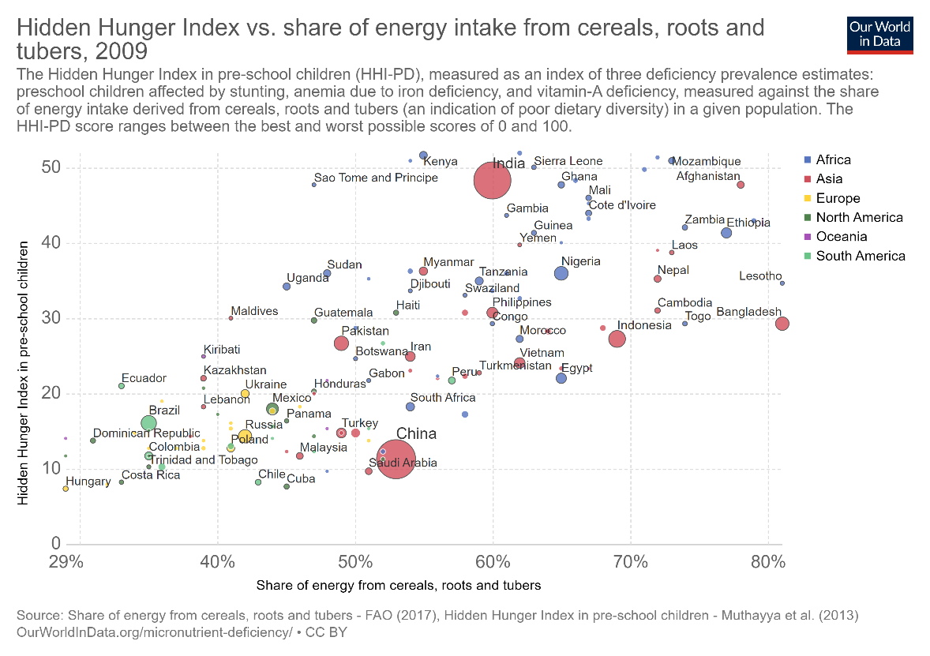
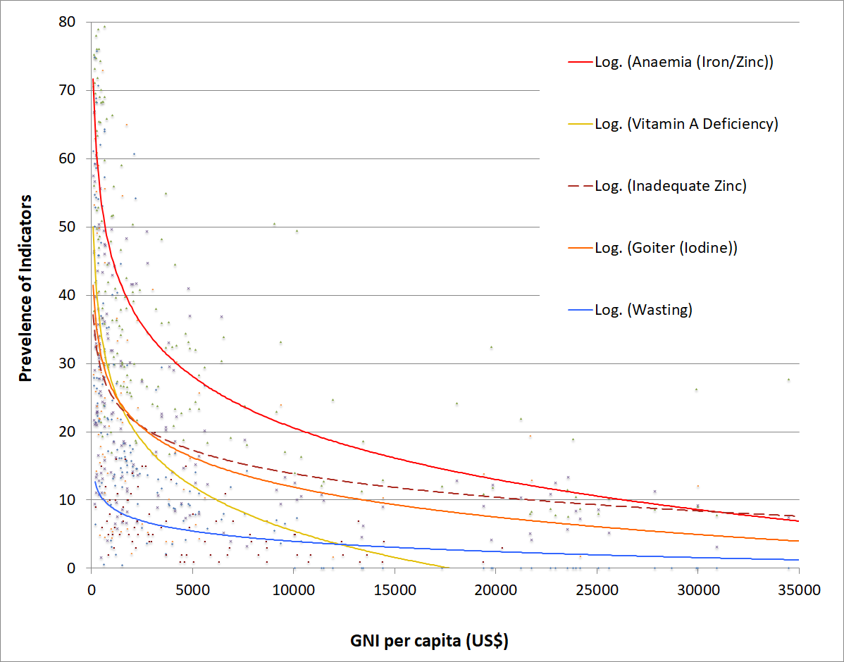
Utilization challenges
Micronutrient deficiencies – ‘hidden hunger’ – are less responsive to income growth. Require dietary change and/or change in mineral/vitamin content of staple foods.
Source: Barrett and Bevis, 2015

Slide 19
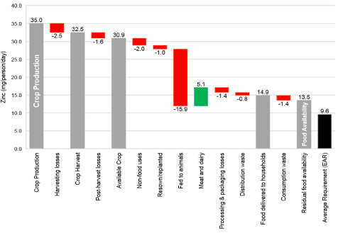
Utilization challenges
Challenge: loss/waste of key nutrients along the path from plant growth to human consumption
Source: Ritchie et al. 2018 FSFS
For some nutrients (calcium, folate) residual food availability <10% >DRs.
Keep in mind, however, loss/waste endogenous to prices.

Slide 20
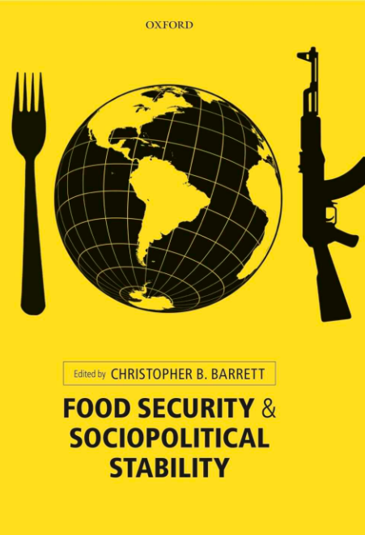
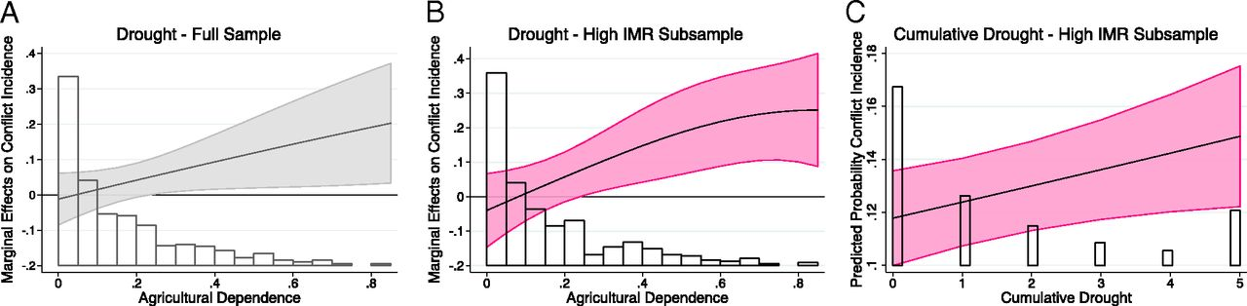
Increased co-location of food insecurity with conflict
Stability challenges
Over past 2 decades, conflict-affected countries’ share of stunted children grew from 46% to 79%. (FAO et al. 2017)
According to UNHCR, ~69mn forcibly displaced people globally now.
And strong relationship between drought and conflict (von Uexkul et al. 2016 PNAS)

Slide 21
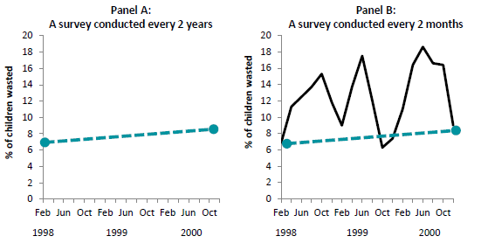
Stability challenges
Seasonality and regular-aperiodic shocks necessitate investments in high-frequency monitoring of sentinel sites in locations w/most vulnerable populations.
Example: the value of intra-seasonal monitoring:
Data from HKI Bangladesh Nutrition Surveillance Program
Need sentinel sites (Barrett Science 2010, Headey & Barrett PNAS 2015)

Slide 22
A sustainable food secure future for all requires innovations:
1. In Africa and Asia, above all.
2. In growing the downstream supply of minerals and vitamins from vegetables, fruits, and animal source foods.
3. Accelerating adaptation to climate change and land/water scarcity, as well as improving soil nutrient cycling.
4. Food value chain enhancements … beyond the farmgate.
5. Enhanced social protection and safety nets for the poorest.
6. Efforts to reduce conflict.
7. Better monitoring/measurement to improve management.
Science and solidarity

Slide 23
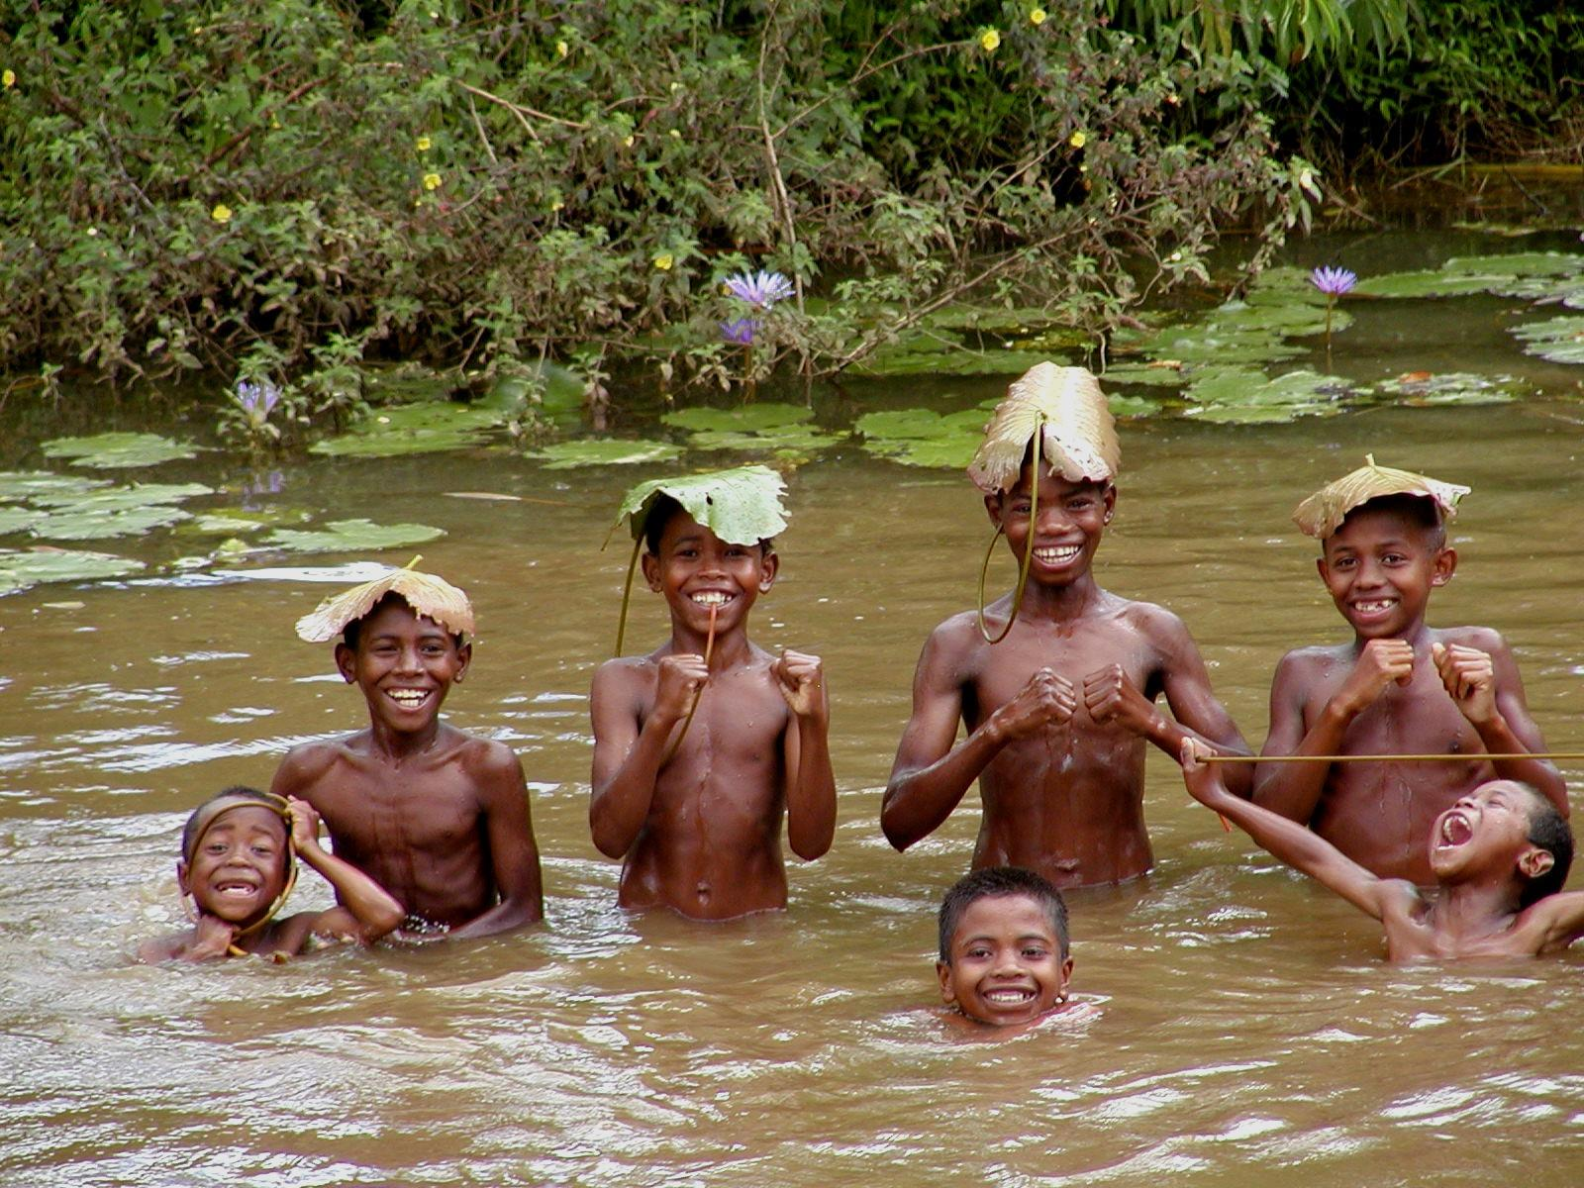
Thank you
Thank you for your time, interest and comments!

